Slide 1



GROUP 25
CEF440
INTERNET PROGRAMMING AND MOBILE PROGRAMMING
Instructor: Dr NKEMINI Valery
APRIL 2024

Slide 2


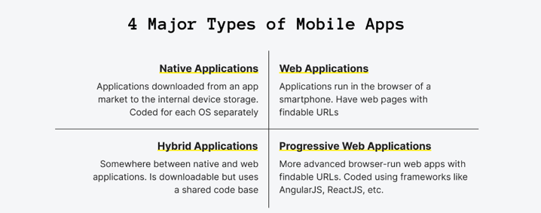
1.MAJOR TYPES OF MOBILE APPS AND THEIR DIFFERENCES (NATIVE, PROGRESSIVE WEB APPS, HYBRID APPS)
There exist various types of mobile applications which differ by purpose and the ways they operate on mobile devices
A mobile application is a kind of software that is created for being run on a mobile device. This includes not only smartphones but also tablets and smartwatches.

Slide 3
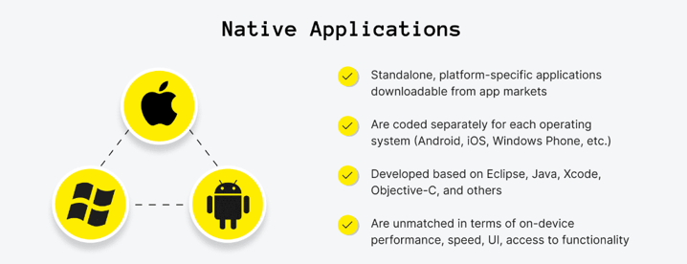
Native Applications
When building native apps developers have to code the app at least twice for Android and iOS so that the audience would have the chance to get it.
Native mobile apps are applications downloaded from an app market to the internal device storage. They are usually coded for each device separately.

Slide 4
Native Applications Advantages and Disadvantages
Advantages
1. Fast performance due to simple code specific to device and OS.
2. Better use of OS and device specific functionalities.
3. Interactive UI/UX.
4. Lesser compatibility issues and faster to configure.
Disadvantages
1. Building OS specific apps can be time-consuming
2. OS specific programming languages like swift and java are hard to learn.
3. Longer release cycles to ensure stability.
4. Requires separate codebase to add new features.
WhatsApp Messenger is a native app example.

Slide 5
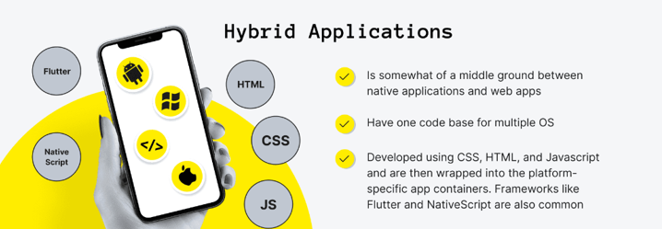
Hybrid Applications
Hybrid applications are also commonly developed using specially designed mobile application development frameworks like Flutter or React Native.
They are developed in one go for all platforms, which means less time and money spent on cross-platform development.

Slide 6
Hybrid Applications Advantages and Disadvantages
Advantages
1. Easy to build
2. Shareable code makes it cheaper than a native app
3. Easy to push new features since it uses a single code base.
4. Can work offline.
5. Shorter time to market, as the app can be deployed for multiple OSs.
Disadvantages
1. Complex apps with many functions will slow down the app.
2. More expensive than web apps
3. Less interactive than native apps
4. Apps cannot perform OS specific tasks
There are tons of hybrid applications today, including Instagram, Gmail, Facebook, and many others.

Slide 7
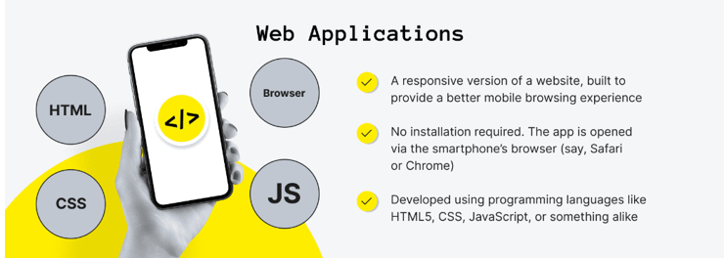
Web Applications
Mobile websites are the version of a website that people see when opening a site from a mobile browser, but they are commonly unoptimized, not user-friendly, slow, and look like the shrunk desktop website version.
Web apps are a responsive version of a website, built to provide a better mobile browsing experience when compared to using the website's regular mobile version.

Slide 8
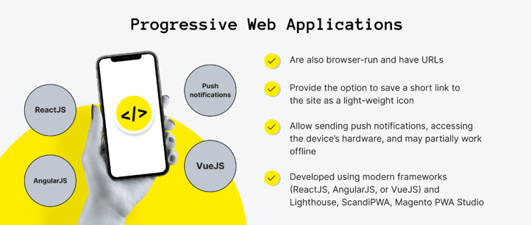
Progressive Web Applications
Progressive web apps are built using modern frameworks like React.js, Angular.js, or Vue.js.
They are typically accessed via a web browser of your choice but can be installed and accessed on a device.

Slide 9
Progressive Web Applications Advantages and Disadvantages
Advantages
1. They use very little data
2. PWAs get updated like web-pages. They automatically get updated every time you use them.
3. There is no need for installation as PWAs are simple web-pages.
4. You can easily share PWAs by simply sending its URL.
Disadvantages
1. There are limitations to using all the Hardware and Operating Systems features.
2. PWAs can pose a few hardware integration problems.
3. Full support is not available in default browsers of some of the manufacturer’s.
4. It cannot use the latest hardware advancements (like fingerprint scanner).
The implementation of progressive web apps has been especially seen in the e-commerce sector recently.

Slide 10

Our Offered Services
List your company's services/products.
List your company's services/products.
Briefly elaborate on what you want to discuss.
List your company's services/products.
List your company's services/products.
List your company's services/products.
Back to Agenda

